Slide 1
NYC Data Profiling and Quality Analysis
By
Chinmay Wyawahare
Hemanth Teja
Vineeth Viswakumar

Slide 2
TASK 1- Generic Profiling
Open data often comes with little or no metadata.
The aim of this task is to profile a large collection of open data sets and derive metadata that can be used for data discovery, querying, and identification of data quality problems.
Number of datasets processed in this task is 1900.

Slide 3
GENERIC PROFILING SUBTASK -1 EXTRACTING METADATA
The main aim of this task is to extract metadata such as :-
Number of non-empty cells
Number of empty cells (i.e., cell with no data)
Number of distinct values
Top-5 most frequent value(s)
Data types (a column may contain values belonging to multiple types)

Slide 4
GENERIC PROFILING SUBTASK -2 IDENTIFYING DISTINCT DATA TYPES FOR EACH COLOUMN
Identify the data types for each distinct column value as one of the following:
INTEGER (LONG)
REAL
DATE/TIME
TEXT

Slide 5
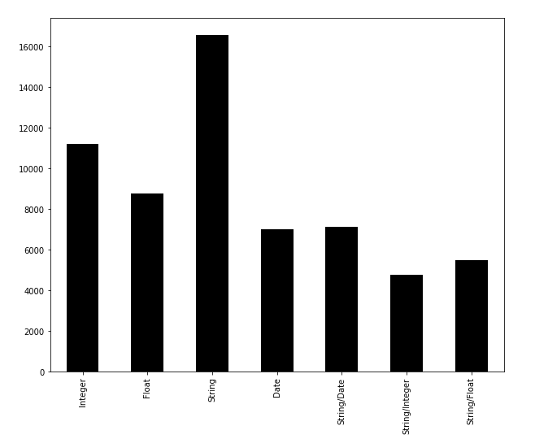
VISUALIZATION OF THE DATA TYPES USED
The bar chart depicts the frequencies of the
different data types used

Slide 6
GENERIC PROFILING SUBTASK -3 STATISTICAL COMPUTATION
For columns that contain at least one value of type INTEGER / REAL , we compute the following statistical data:
Maximum value
Minimum value
Mean
Standard Deviation
For columns that contain at least one value of type DATE , we compute:
Maximum value
Minimum value

Slide 7
GENERIC PROFILING SUBTASK -4 STRING BASED COMPUTATION
For columns that contain at least one value of type TEXT , we compute:
Top-5 Shortest value(s) (the values with shortest length)
Top-5 Longest values(s) (the values with longest length)
Average value length

Slide 8
TASK 2 – SEMANTIC PROFILING
Semantic profiling is a technique using semantic-based tools and ontologies in order to gain a deeper understanding of the information being stored and manipulated in an existing system
The goal of this task is to identify and summarize semantic types present in the column.
These can be generic types (e.g., city, state) or collection-specific types (NYU school names, NYC agency).
For each semantic type T identified, enumerate all the values encountered for T in all columns present in the collection.

Slide 9
GOAL OF THE TASK
TYPES | TYPES
Person Name | Business Name
Phone Number | Address
Street Name | City
Neighborhood | LAT/LON
Zip Code | Borough
School Name | Color
Car Make | City Agency
Areas of study | Subjects in school
University Names | Websites
Building classification | Vehicle Type
Types of Location | Parks/Playground
The aim of the task is to classify the attribute of the column into the types listed and add one or more semantic type labels to the column metadata together with their frequency in the column. The types listed are listed in the table.

Slide 10
TECHNIQUES USED FOR SEMANTIC PROFILING
TECHNIQUE 1-FUZZY RATIO
This in-built python module helps compute a ratio function that computes the standard Levenshtein distance similarity ratio between two sequences.
Levenshtein distance (LD) is a measure of the similarity between two strings, which we will refer to as the source string (s) and the target string (t). The distance is the number of deletions, insertions, or substitutions required to transform s into t

Slide 11
TECHNIQUES USED FOR SEMANTIC PROFILING
TECHNIQUE 2- REGULAR EXPRESSIONS
A regular expression, regex or regexp is a sequence of characters that define a search pattern. Usually such patterns are used by string searching algorithms for "find" or "find and replace" operations on strings, or for input validation.
A RegEx, or Regular Expression, is a sequence of characters that forms a search pattern.
RegEx can be used to check if a string contains the specified search pattern.
Python has a built-in package called re – which can be used to work with regular expressions.

Slide 12
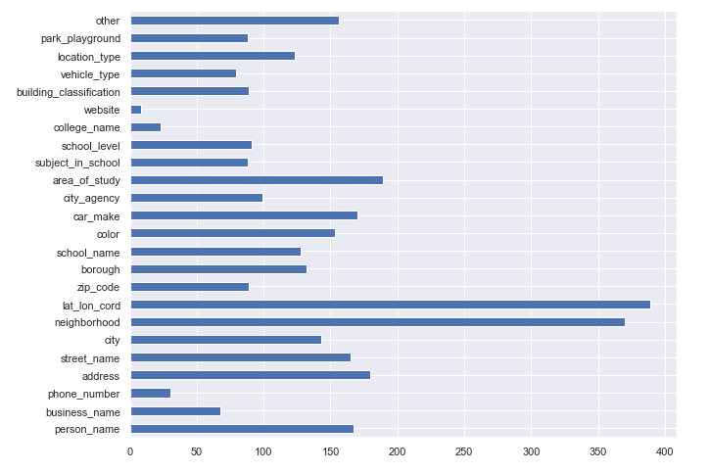
VISUALIZING FREQUENCIES OF THE MULTIPLE SEMANTIC TYPES

Slide 13
TASK 3 – DATA ANALYSIS
In this task, we identify the three most frequent 311 complaints types ordered by borough types.
We also compute if the complaint types are frequent in all the five boroughs of the city.
DATASET USED:
➔The dataset used for the computation of this task can be found in the NYC open data website.
➔The data set contains details of all the 311 service requests from 2010 to the present day. Some of the important attributes of the dataset are:-
IMPORTANT ATTRIBUTES | IMPORTANT ATTRIBUTES
Unique key | Created/closed dates
Agency Name | Complaint Type
Resolution Description | Borough Details
Community board | Address

Slide 14
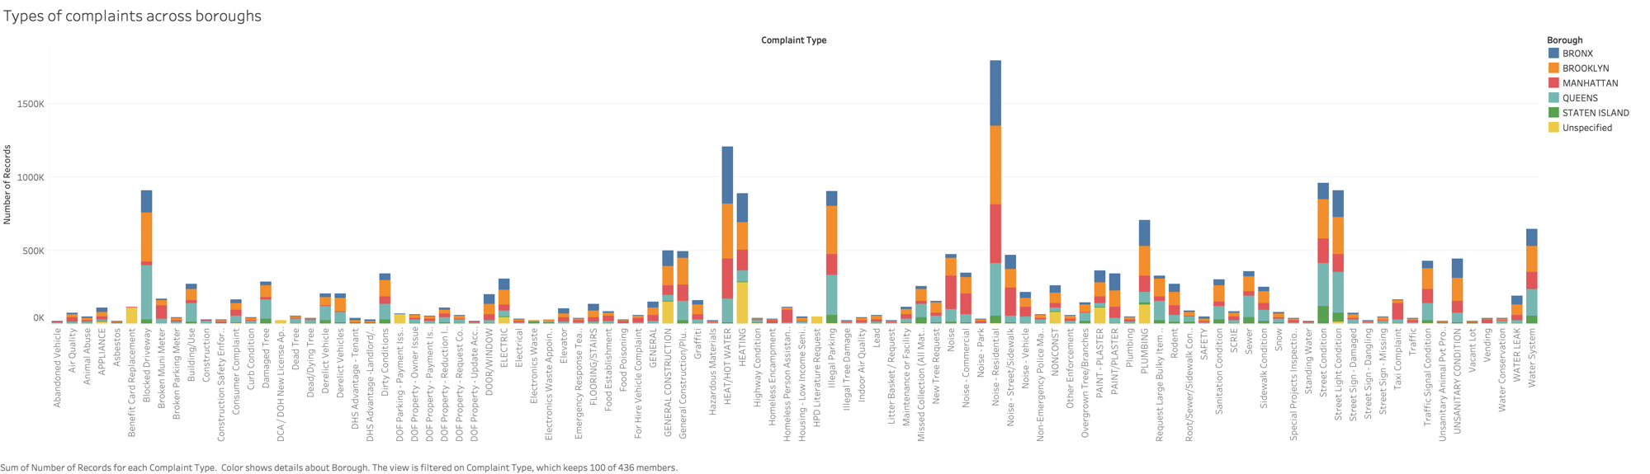
DATA ANALYSIS VISUALIZATION The types of complaints across boroughs

Slide 15
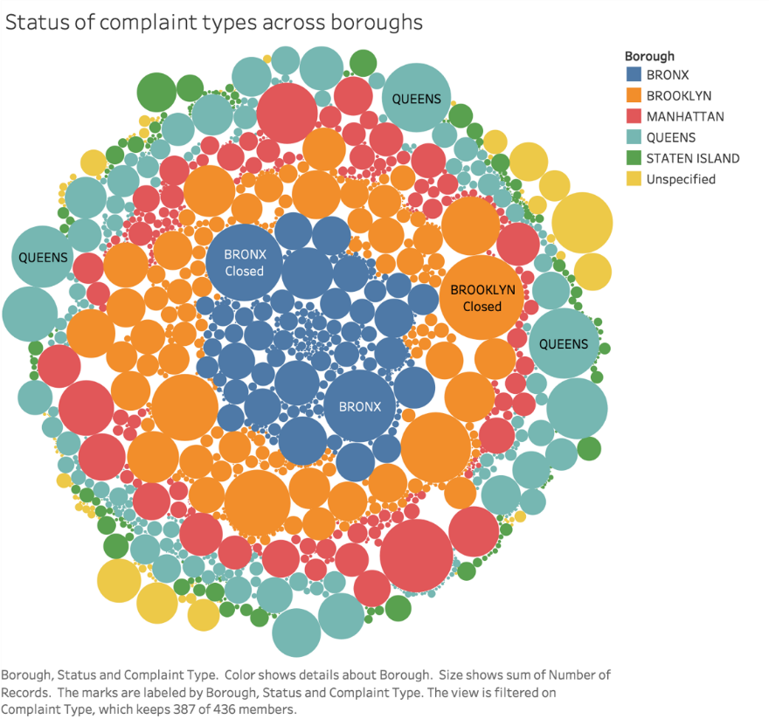
DATA ANALYSIS - VISUALIZATION Status of complaint types across boroughs

Slide 16
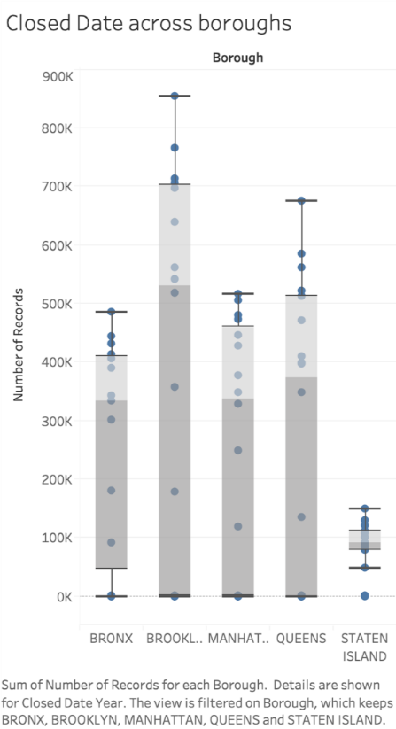
DATA ANALYSIS - VISUALIZATION Closed dates across boroughs

Slide 17
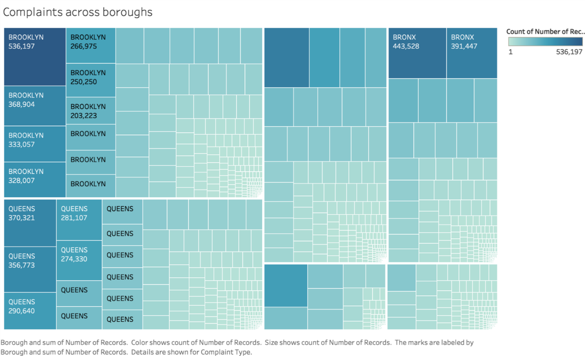
DATA ANALYSIS - VISUALIZATION Heat Map – Count of the complaints across the boroughs

Slide 18
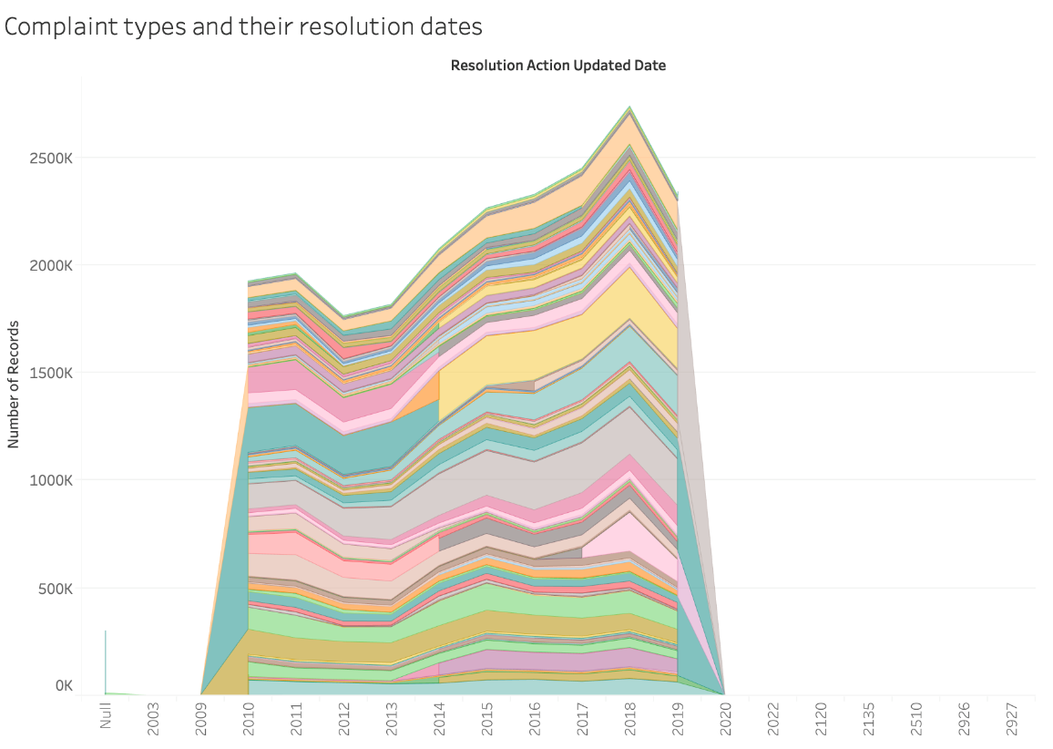
DATA ANALYSIS - VISUALIZATION Complaint types and their resolution types

Slide 19
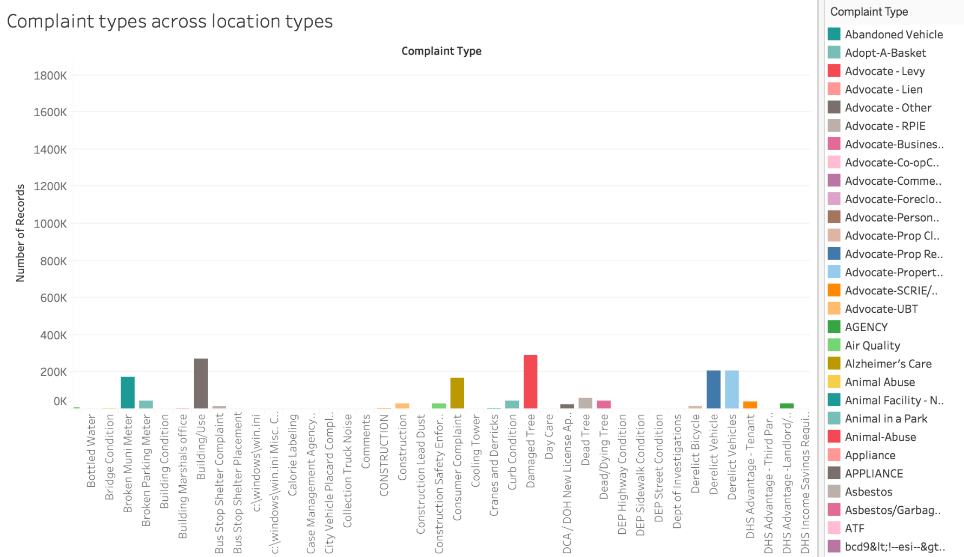
DATA ANALYSIS - VISUALIZATION Complaint types across different location types

Slide 20
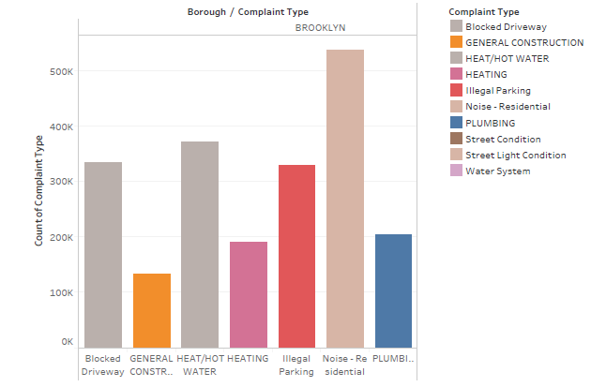
DATA ANALYSIS - VISUALIZATION Top frequent complaint types for Brooklyn
From this visualization of the
complaint types issued by the people
of Brooklyn , we can infer that:
noise in residential areas is the most
issued complaint.

Slide 21
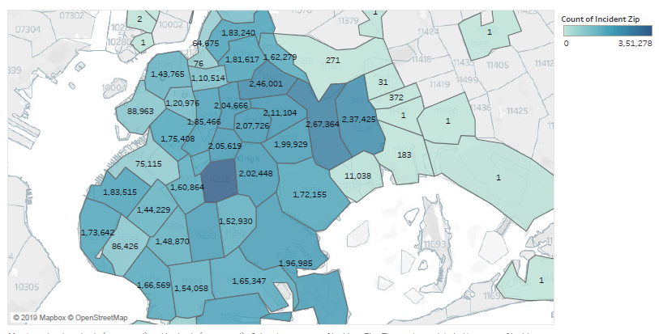
DATA ANALYSIS - VISUALIZATION Heat Map of Brooklyn representing the frequency of open complaints in various regions.

Slide 22
THANK YOU

